Slide 1
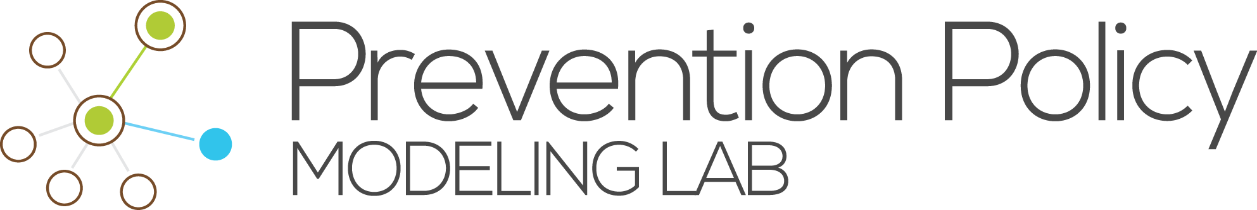
A Syphilis Transmission Model at the State Level
Jessie Lowell, Prevention Policy Modeling Lab
NEEMA All Grantee Meeting, Atlanta
October 11th-12th, 2018

Slide 2
Major Research Questions
In the face of limited resources, what approaches to screening would be most effective at reducing syphilis burden in the population?
What levels of investment in contact tracing are most effective? Is this different for different population groups?
What is the estimated impact of more frequent screening versus expanded screening coverage in different contexts, and how does this vary by population group?
Notes:
Just read this. Kathy brought up contact tracing, we are collaborating with MA to get data.

Slide 3
Progress
Calibration almost finalized – large improvements to Louisiana calibration
Initial implementation of contact tracing
Manuscript in preparation
Notes:
Calibration data includes case report numbers, staging percentages, relative risks of different demographic groups, syphilis/HIV co-infection

Slide 4
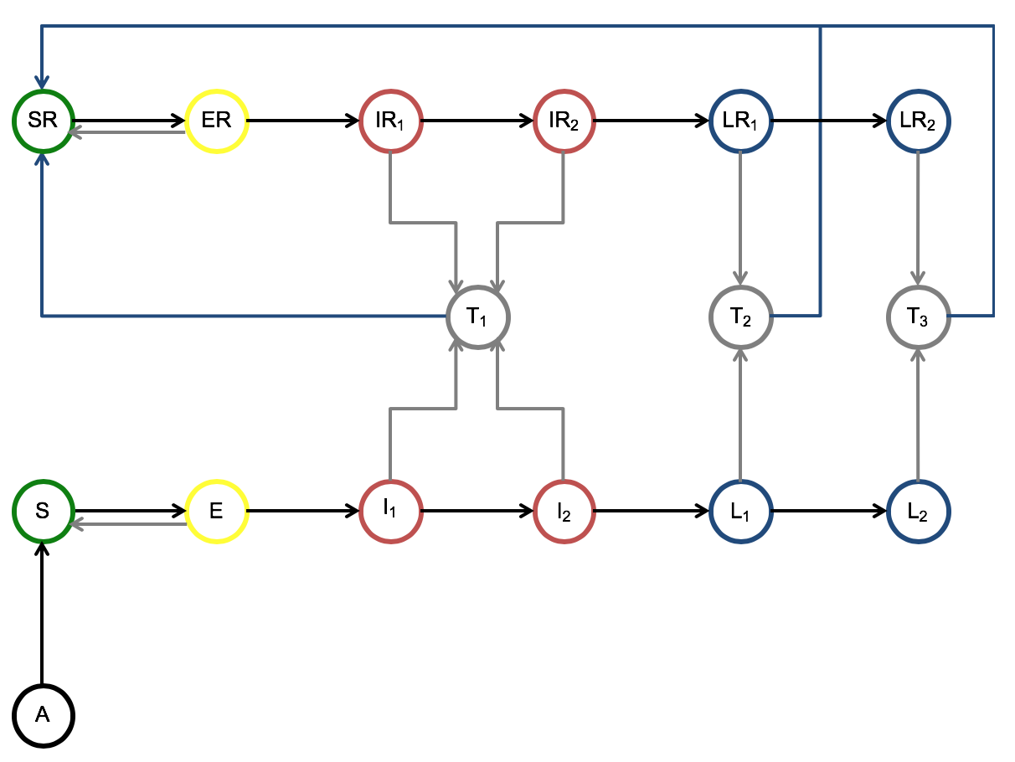
Model & Methods
Dynamic compartmental mathematical model
Population stratified by age, sex, race/ethnicity, level of sexual activity
Natural history by stage
Began tracking individuals with a prior infection history 5 years before the calibration start period
‘Never sexually active’ compartment
Notes:
After this, announce the transition - say that we're going to zoom in, say that we're going to do results and then contact tracing. Include Louisiana results, can mention that it is harder than MA because numbers swing around more.

Slide 5
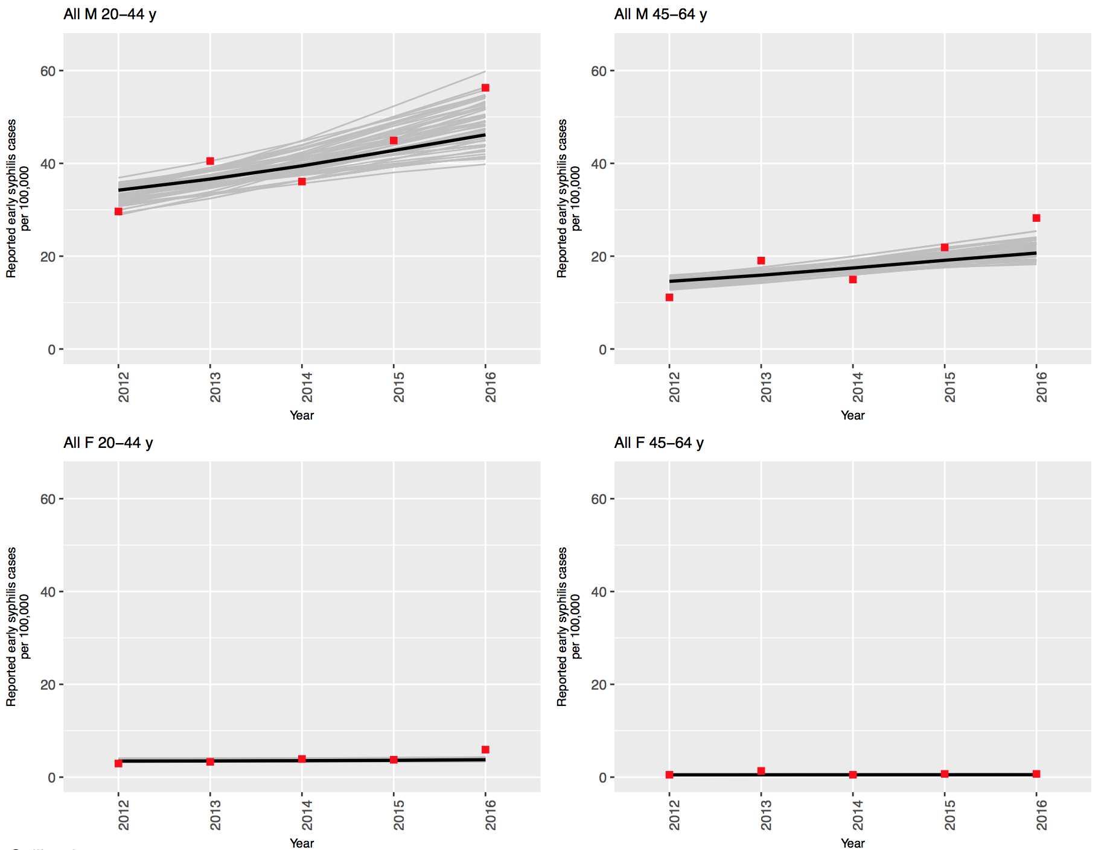
Calibration Results – Case Reports - MA
Notes:
These are some results that we are getting. Mention hoping to get 2017 data into this, to sync it with contact tracing data.

Slide 6
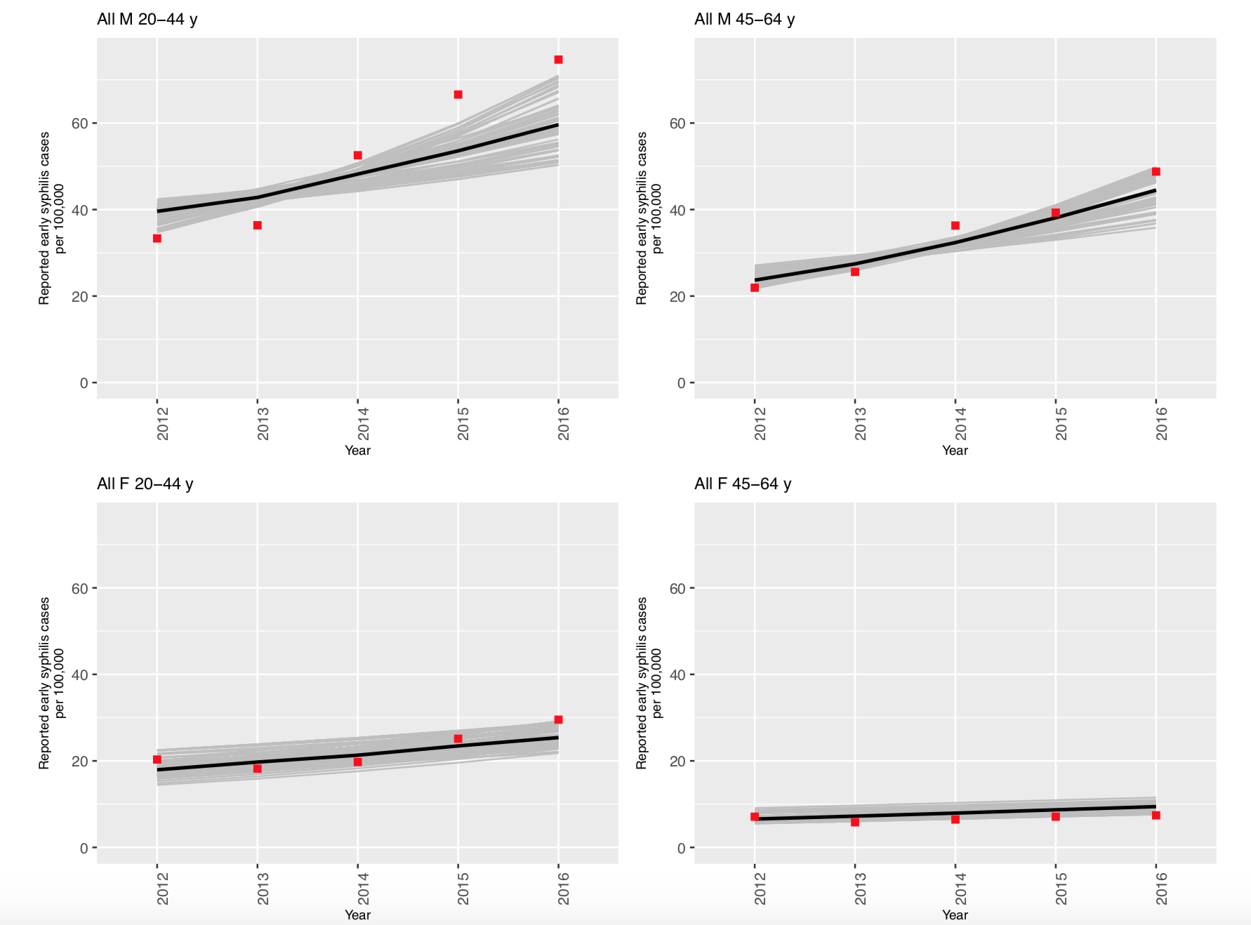
Calibration Results – Case Reports - LA
Notes:
As you can see, Louisiana has been more difficult to calibrate to than Massachusetts, particularly for men. This is because the numbers in Louisiana, especially for men, swing much more and more steeply in LA. In addition, there have been various changes to the LA health system in recent years, including a grant in 2012 to screen men of color. We have tried to capture these large swings by focusing on time-dependent variables, particularly the screening rates, which are set by Bezier curve control points that follow a beta distribution. We have improved calibration results by loosening MSM screening rates for the most recent years. Screening/disease/reporting trichotomy, talk about convos with LDPH [talk about why, talk about which variables are the leverage ones]

Slide 7
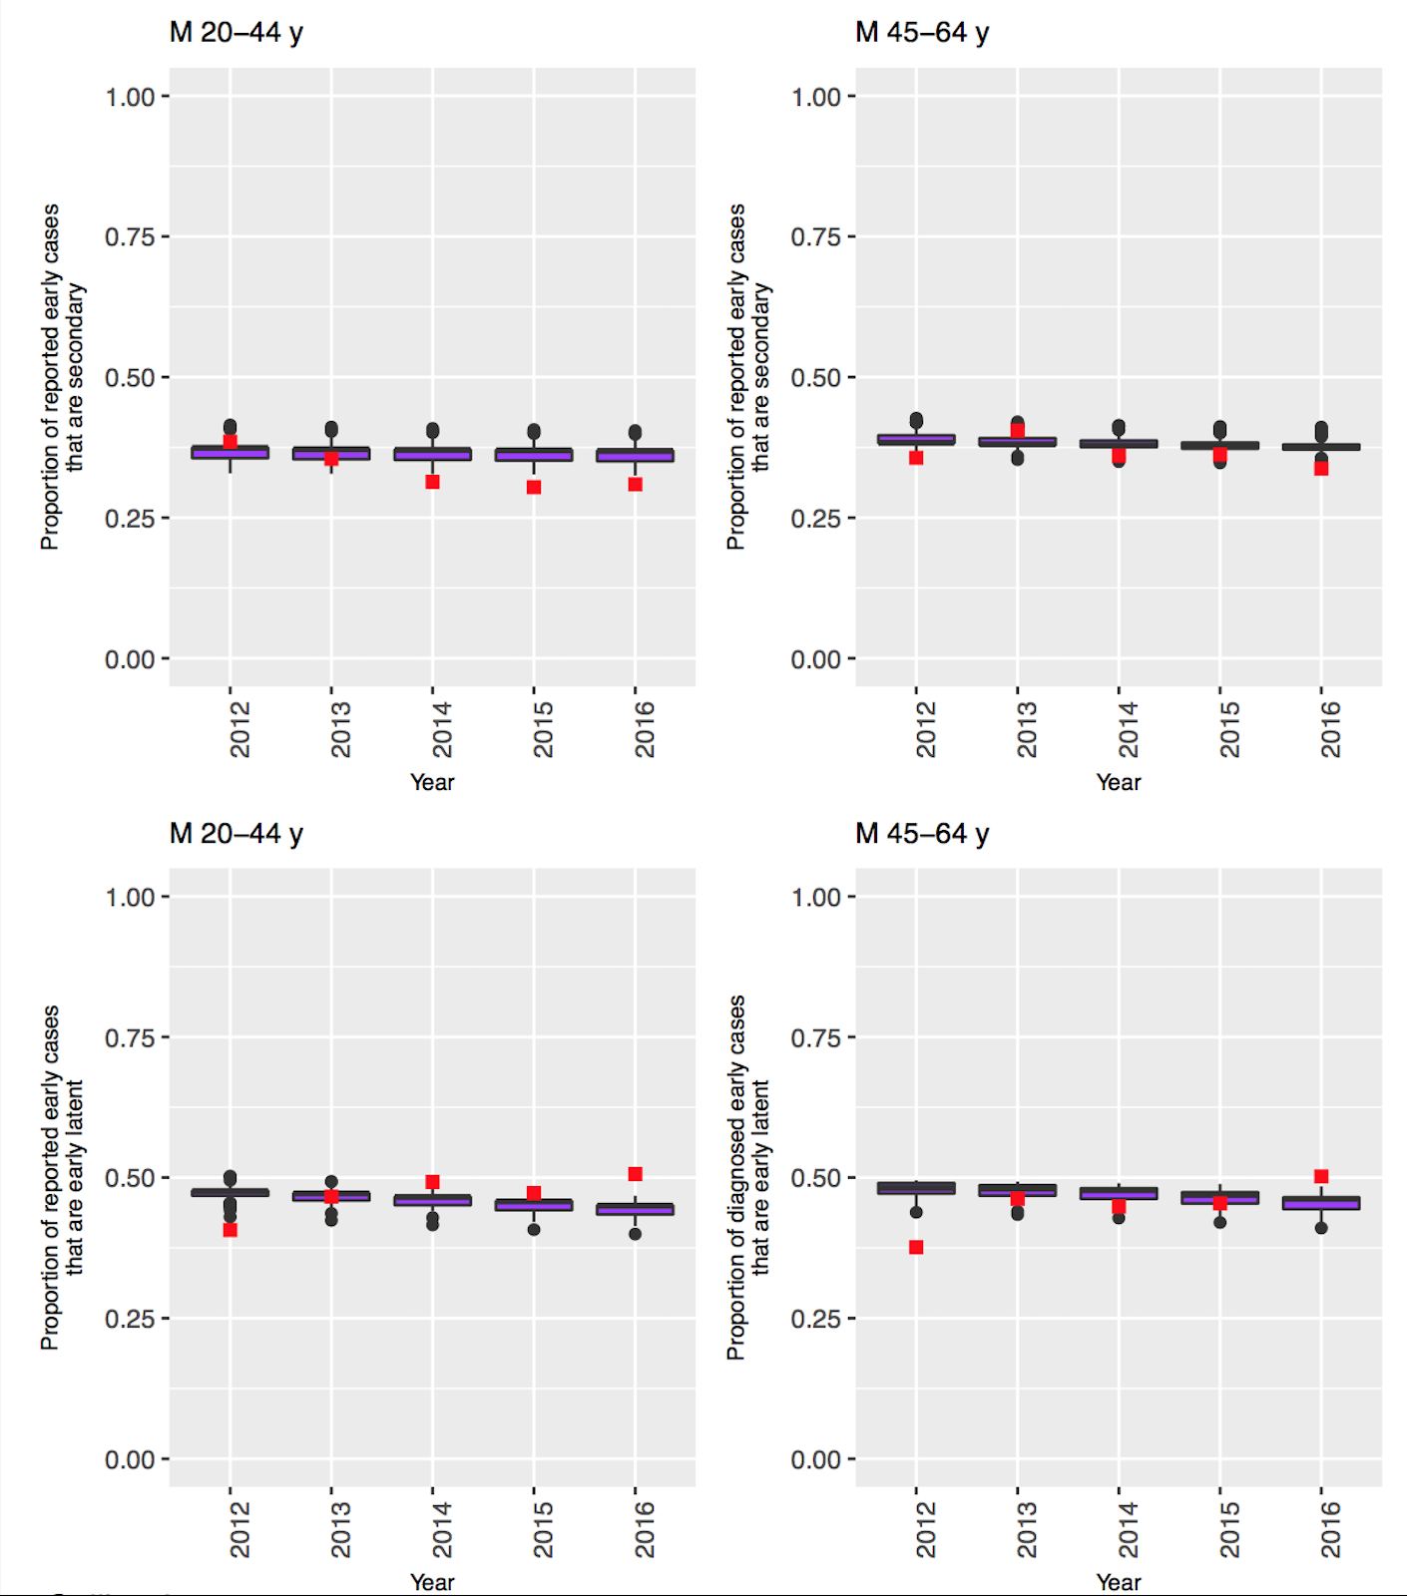
Calibration Results – Prop. Secondary/EL - MA
Notes:
These are some other results that we are getting, from Massachusetts. Deep dive into men.

Slide 8
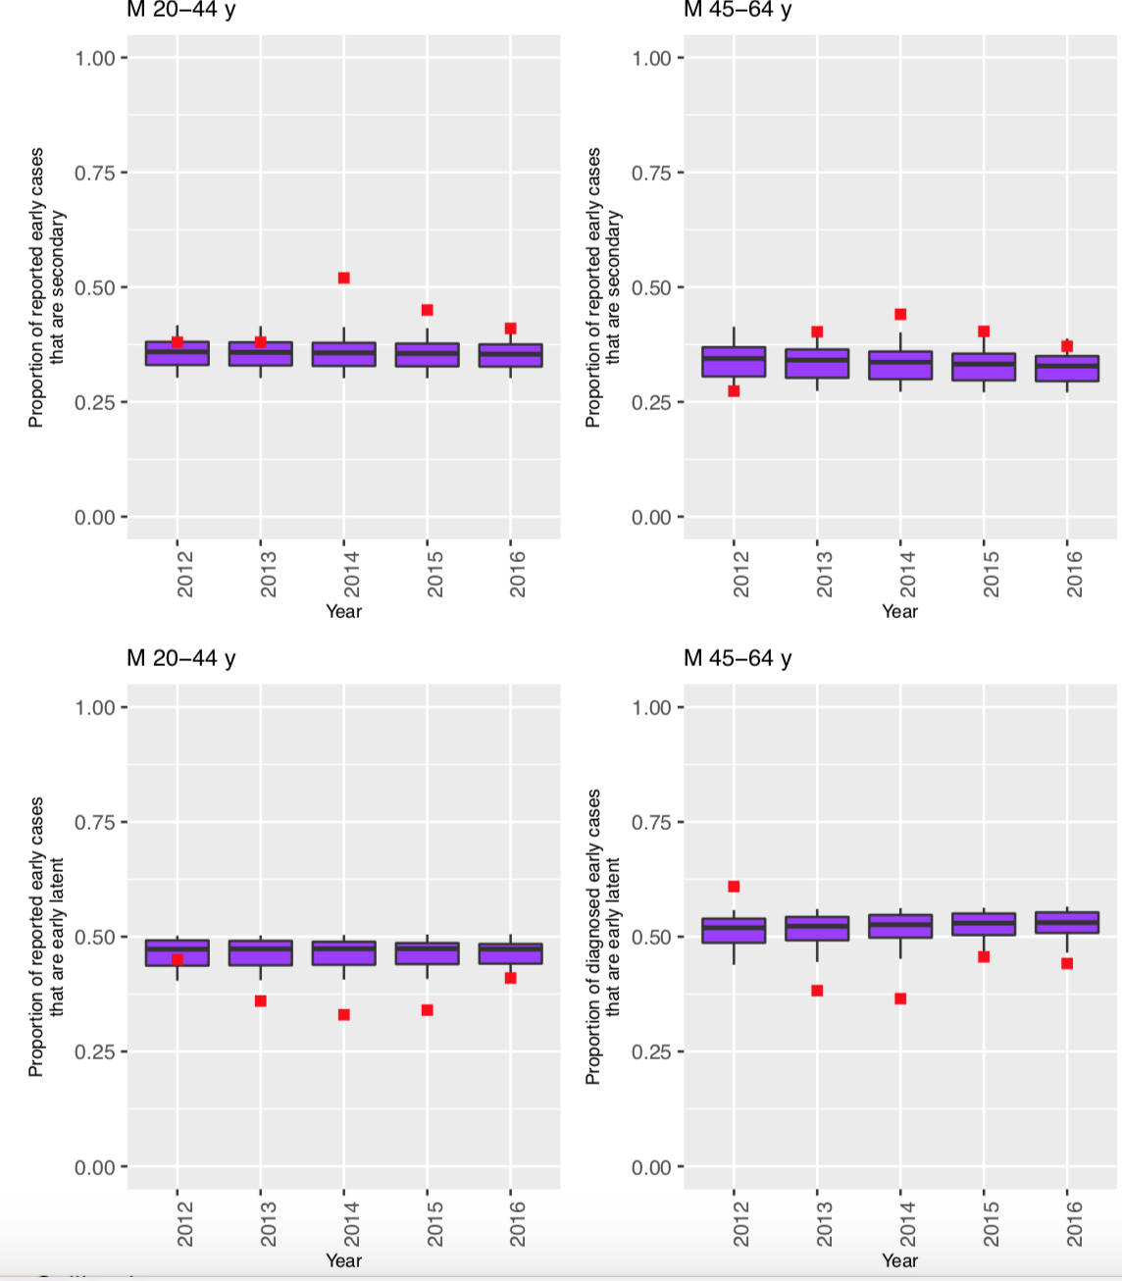
Calibration Results – Prop. Secondary/EL - LA
Notes:
These are some other results that we are getting, from Louisiana. Deep dive into men. Tradeoff between case reports calibration and staging calibration.

Slide 9
Contact Tracing
Brought up by collaborators at Massachusetts DPH
State departments of public health invest significant resources into syphilis contact tracing
Adjustable parameters for percentage of screening rate accounted for by contact tracing
Stratification of contact tracing rates by demographic group
Notes:
Read this. There is previous work suggesting that contact tracing is cost-effective for syphilis, but we can invest different levels of resources into it relative to other types of screening, and need to figure out what is most effective.

Slide 10
Contact Tracing Data
2014 data omitted for unreliability
Notes:
Massachusetts. One possibility is that as other screening goes up for men of color (this is both MSM & MSW), proportion contact traced goes down. But illustrates why this is useful to put into the model – this stuff changes!

Slide 11
Next Steps and Possible Interventions
More sophisticated contact tracing
Finalize calibration
Implement interventions
Targeted screening:
Increased frequency of testing for those who have previously been positive
Benefits of contact tracing – by state?
Notes:
Use “possible interventions” language – “we’re looking to you to help us understand what would be most beneficial.” Contact tracing by jurisdiction might be important question? Could operationalize using multiplier on background rate of detection, could calibrate to MA data

